Slide 1
Musical Instruments and Dances of India

Slide 2
Classical Music Of India
The origins of Indian classical music can be found in the Vedas (Samaveda), which are the oldest scriptures in the Hindu tradition.
Indian classical music has also been significantly influenced by Indian folk music and Persian music.
Two types of Indian classical music:
Hindustani classical music: Hindustani music is mainly found in North India, Khval and Dhrupad are its two main forms,
Carnatic Classical Music: Carnatic music is popular in South India
Like Western classical music, Indian classical music divides the octave into 12 semitones of which the 7 basic notes are, in ascending tonal order,
Sa Re Ga Ma Pa Dha Ni Sa for Hindustani music and
Sa Ri Ga Ma Pa Dha Ni Sa for Carnatic music,
similar to Western music's Do Re Mi Fa Sol La Ti Do.

Slide 3
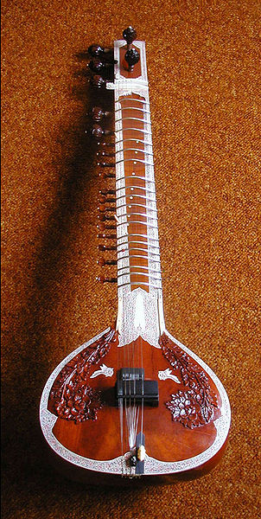
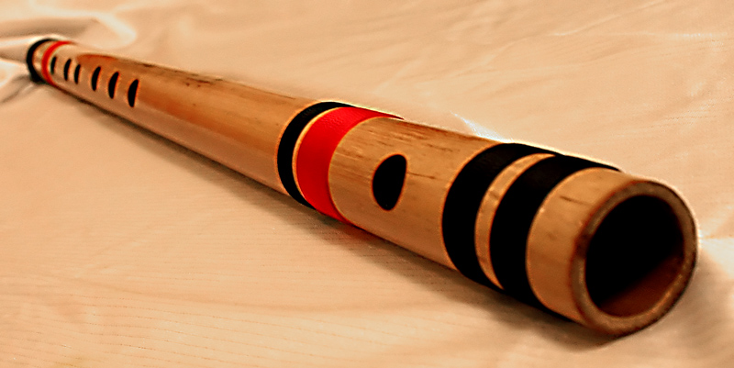
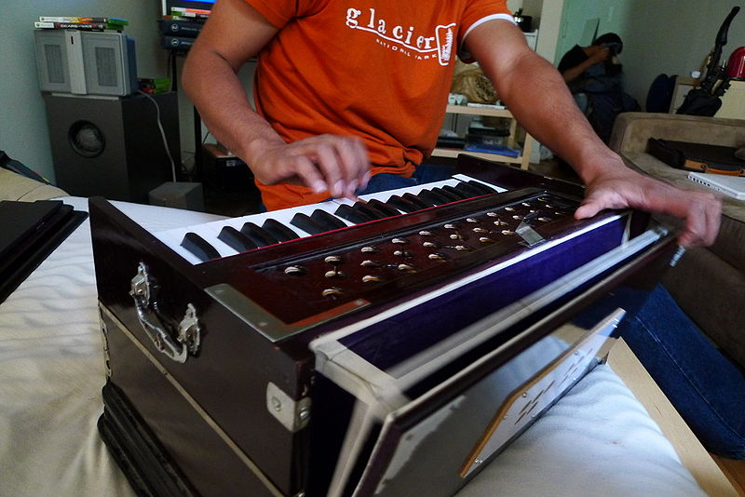
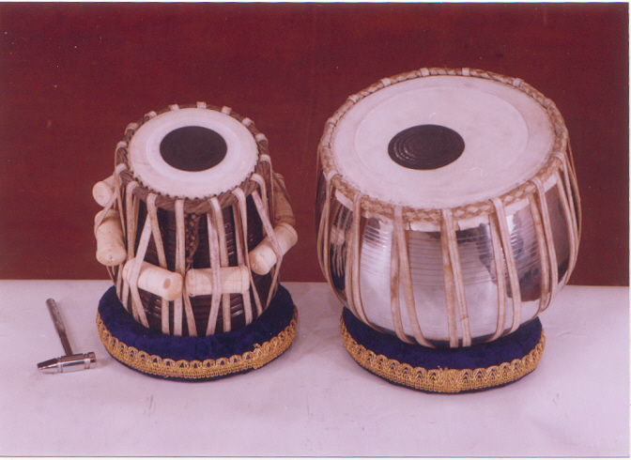
Musical Instruments – Hindustani classical music
Sitar
Bansuri or Flute
Harmonium
Tabla

Slide 4
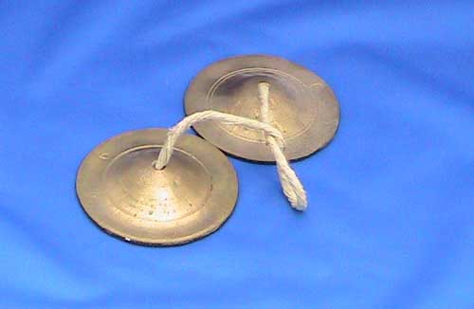
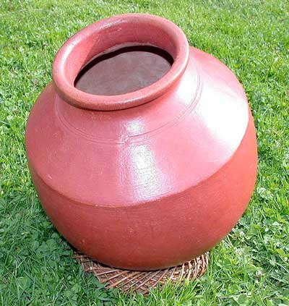
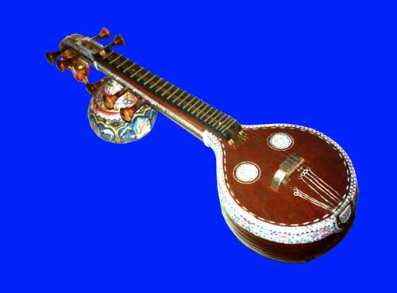
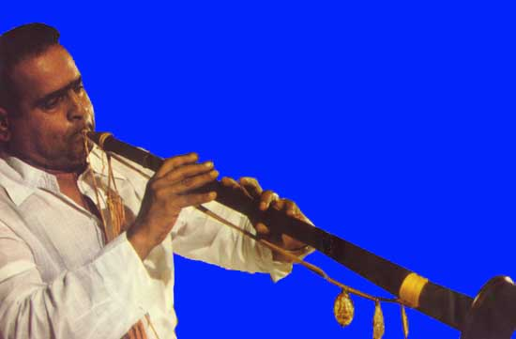
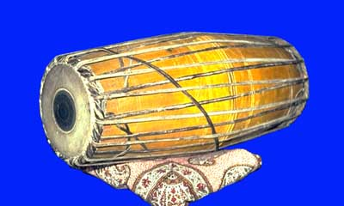
Musical instruments – Carnatic music
Manjira
Ghatam
Veena
Nadaswaram
Mridangam

Slide 5
Dances of India
Different forms of dances originated in different parts of India, developed according to the local traditions.
Classical Dances
Sangeet Natak Akademi, the national academy for performing arts, recognizes eight distinctive traditional dances as Indian Classical Dances, which might have origin in religious activities of distant past.
Folk Dances
Folk dances are numerous in number and style, and vary according to the local tradition of the respective state, ethnic or geographic regions.

Slide 6
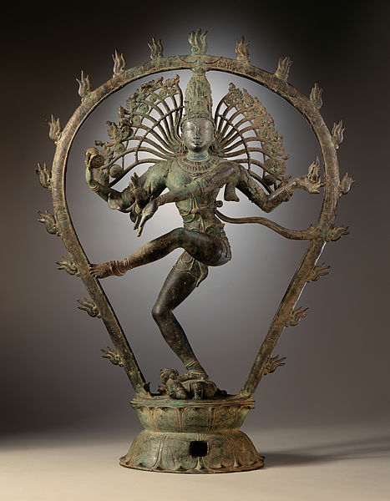
Shiva as Nataraja is worshipped as the Lord of Dance in Hinduism

Slide 7
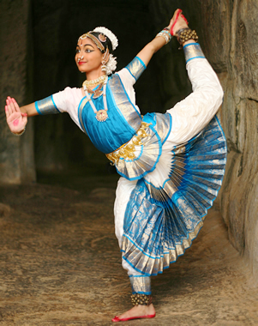
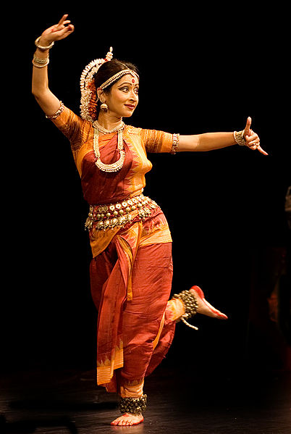
Classical Dances of India
Bharatanatyam
Odissi

Slide 8
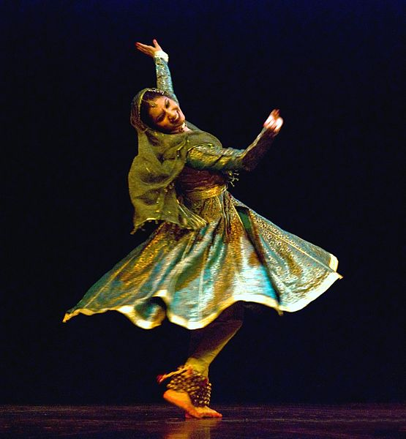
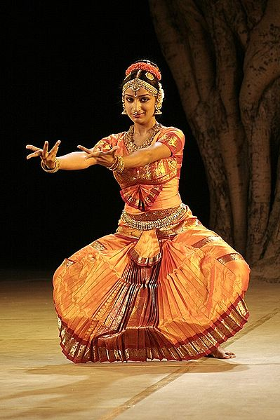
Classical Dances of India
Kathak
Kuchipudi

Slide 9
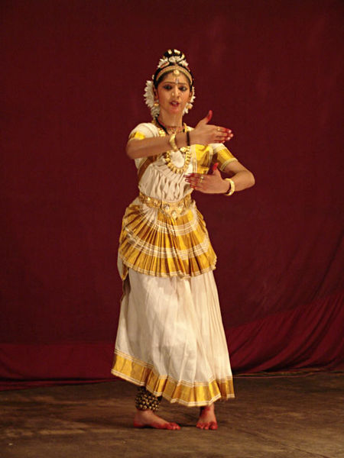
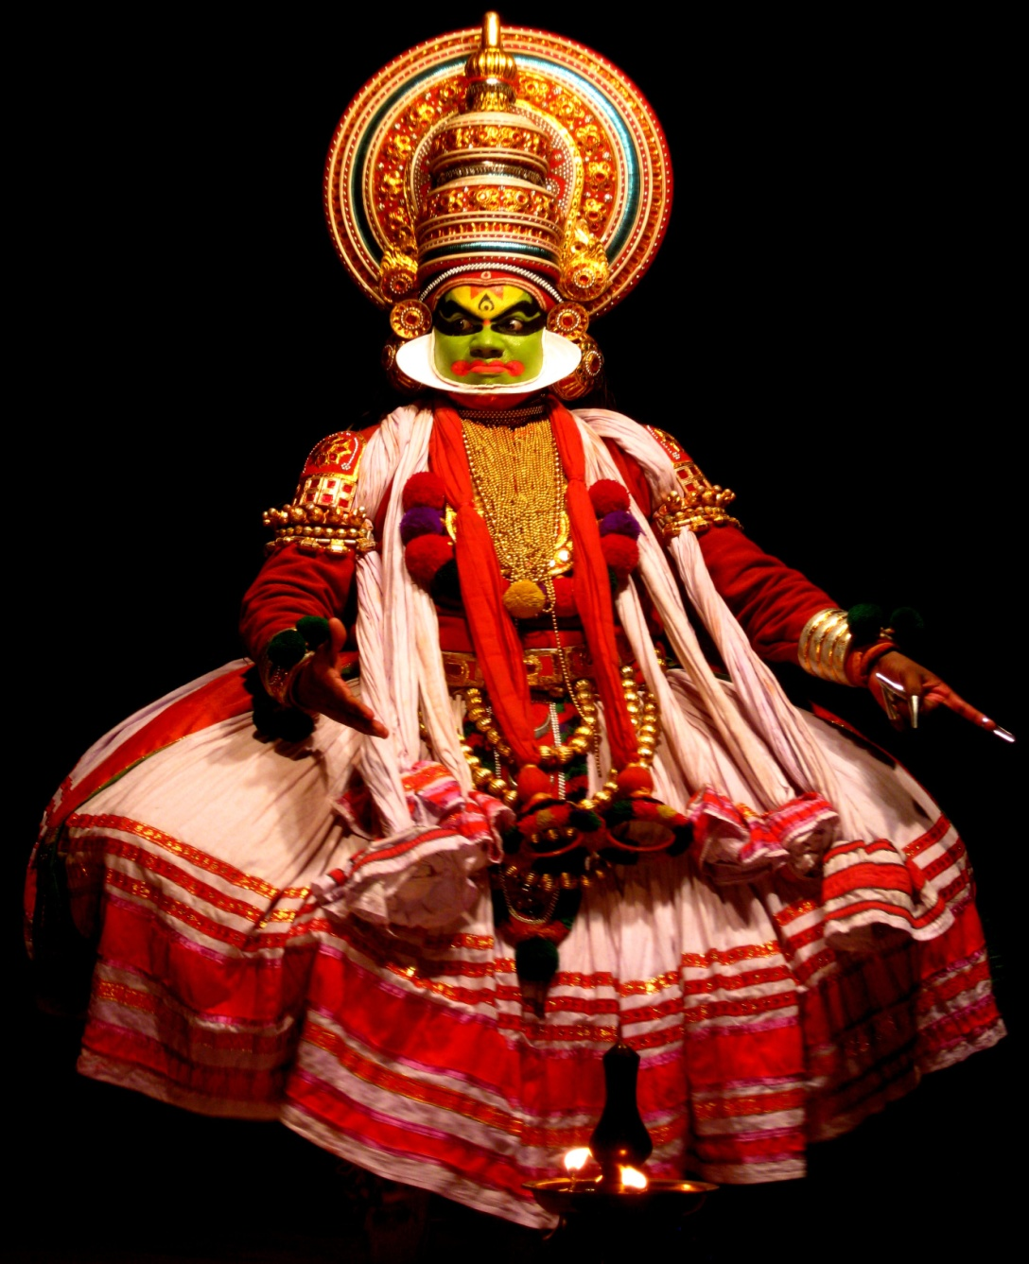
Classical Dances of India
Mohiniyattam
Kathakali – Dance drama of Kerala

Slide 10
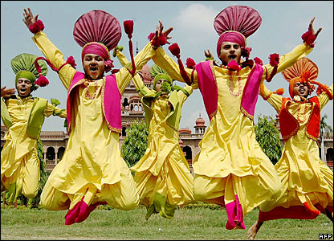
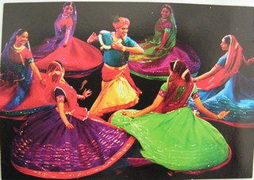
Popular Folk Dances of India
Bhangra from Punjab
Garba from Gujarat

Slide 11
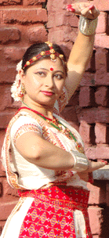
Classical Dances of India
Manipuri
Sattriya

